Slide 1
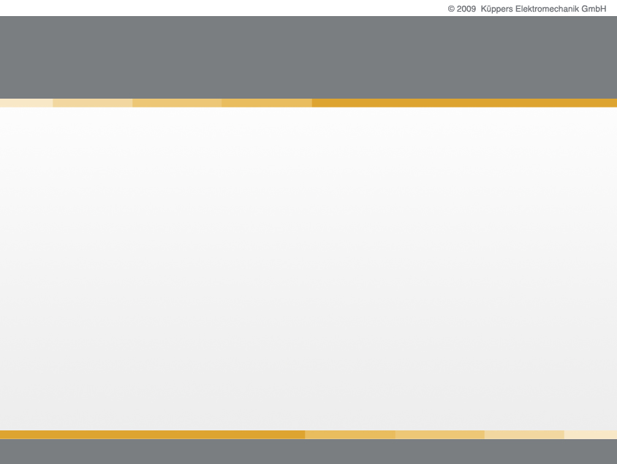

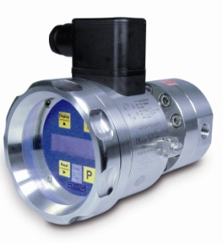
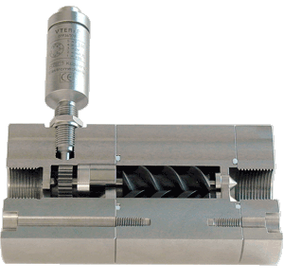
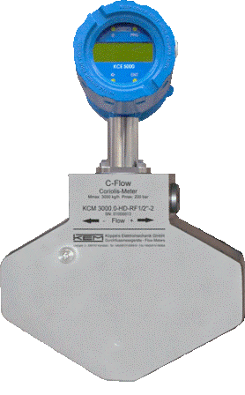


Flow Measurement
Flow Measurement
Coriolis Mass Flow Meter

Slide 2
basics & principles
basics & principles
Operating principle
  2 parallel tubes vibrate one against the other on their natural frequency
  A flow through the tubes delays the oscillation at the incoming side and accelerates it at the outgoing side
  The time shift between incoming and outgoing side only depends on the geometry and the mass flow through the tubes
  The time shift therefore gives the mass flow
  The oscillating frequency gives the density of the medium
  For compensating for temperature effects a temperature sensor is built in

Slide 3
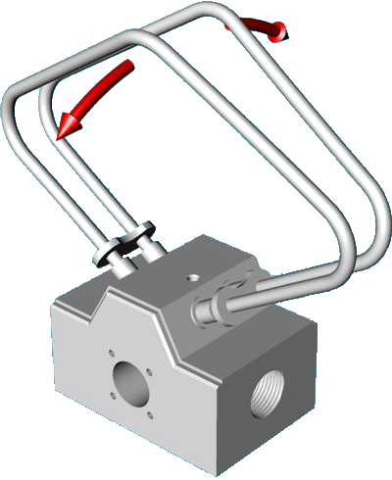
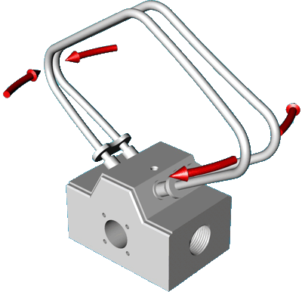
basics & principles
basics & principles
Effect of Coriolis-Force in Tubes
Tube vibration – No Flow
Tube vibration – Full Flow

Slide 4
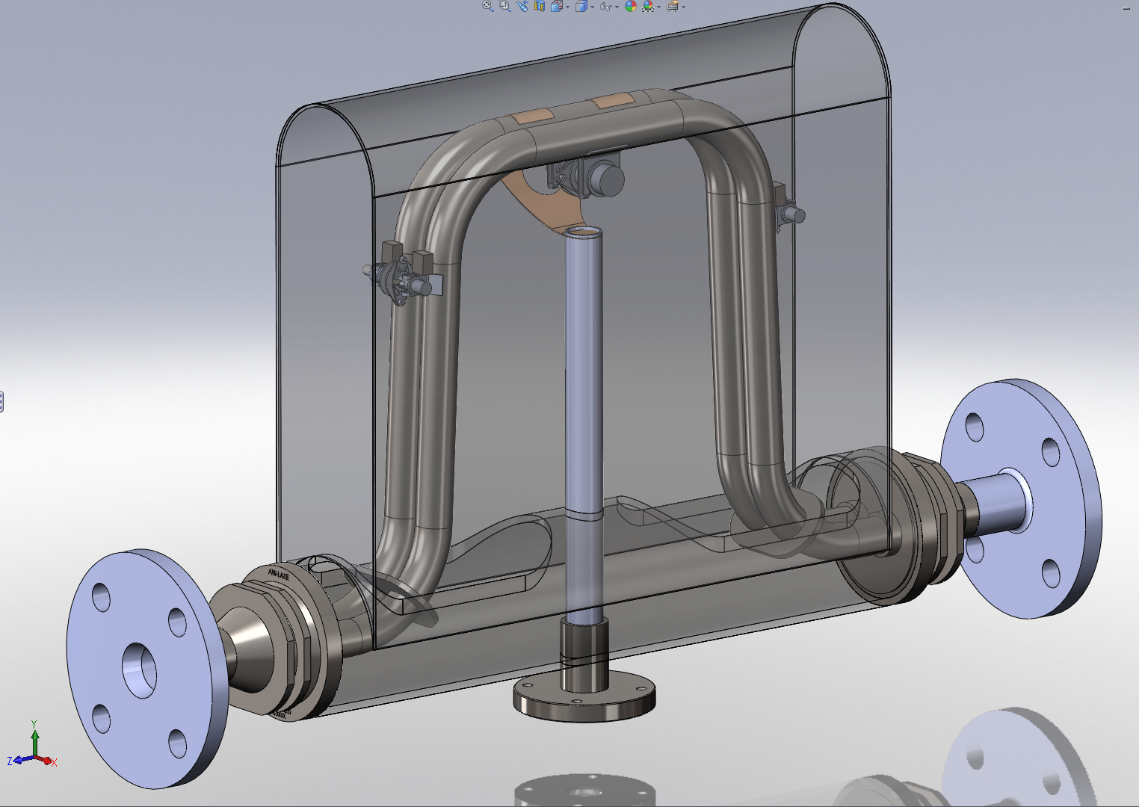
basics & principles
basics & principles
A TCM28k from inside

Slide 5
basics & principles
basics & principles
Advantages of a Coriolis Mass Flow Meter
  Highest accuracy
  4 Measurements with 1 meter (mass flow, volume flow, density, temperature)
  No moving parts
  Suitable for high viscosity fluids
  Solid particles in the fluid will not block or destroy the meter
  No inlet or outlet zone necessary
  Maintenance free
Limitations
  Sensitive to external vibrations
  Not suited for 2- phase or 3- phase media, that means liquids with (bigger) gas bubbles or solid particles

Slide 6
basics & principles
basics & principles
KCM / TCM Series
Type | Measuring Range
 | kg/h
KCM 0300 | 3 | up to | 300
KCM 0600 | 6 | up to | 600
KCM 1500 | 15 | up to | 1 500
KCM 3000 | 30 | up to | 3 000
TCM 5500 | 55 | up to | 5 500
TCM 7900 | 79 | up to | 7 900
TCM 28K | 280 | up to | 28 000
TCM 65K | 650 | up to | 65 000

Slide 7
basics & principles
basics & principles
Possible Media
  All kinds of fluids like diesel, fuel, heavy oil chemicals, polyurethane components, adhesives, paints
  Contaminated fluids (at reduced accuracy)
  High density or liquefied gas (CNG, LNG, LPG)
Allowed Process Parameter
  Temperature: -40°C to 100°C, optional up to 150°C
  Pressure: up to 350bar (option, not all sizes)
  Viscosities: 0 to more than 10 000 mPas

Slide 8
basics & principles
basics & principles
Principle Tasks for the Electronics
  Measure a time shift of 1ns to 40µs with an accuracy of about 1ns
  Note: in 1ns the light travels about 30cm!
  Calculate Flow and Density
  Present the results as current / frequency / display value to the outside world
Additional Tasks
  Never get disturbed by EMI (Electro Magnetic Interference)
  React to any requests from outside (interface, pushbutton) without making a mistake in measuring the time and calculating the flow

Slide 9
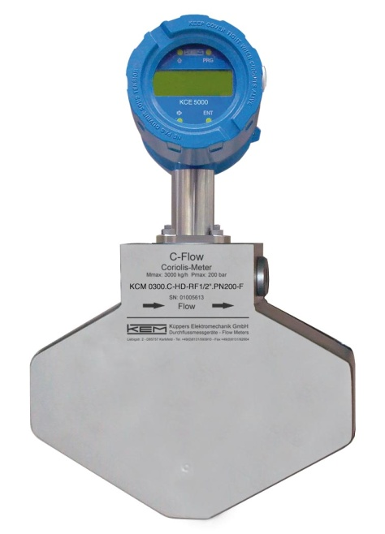
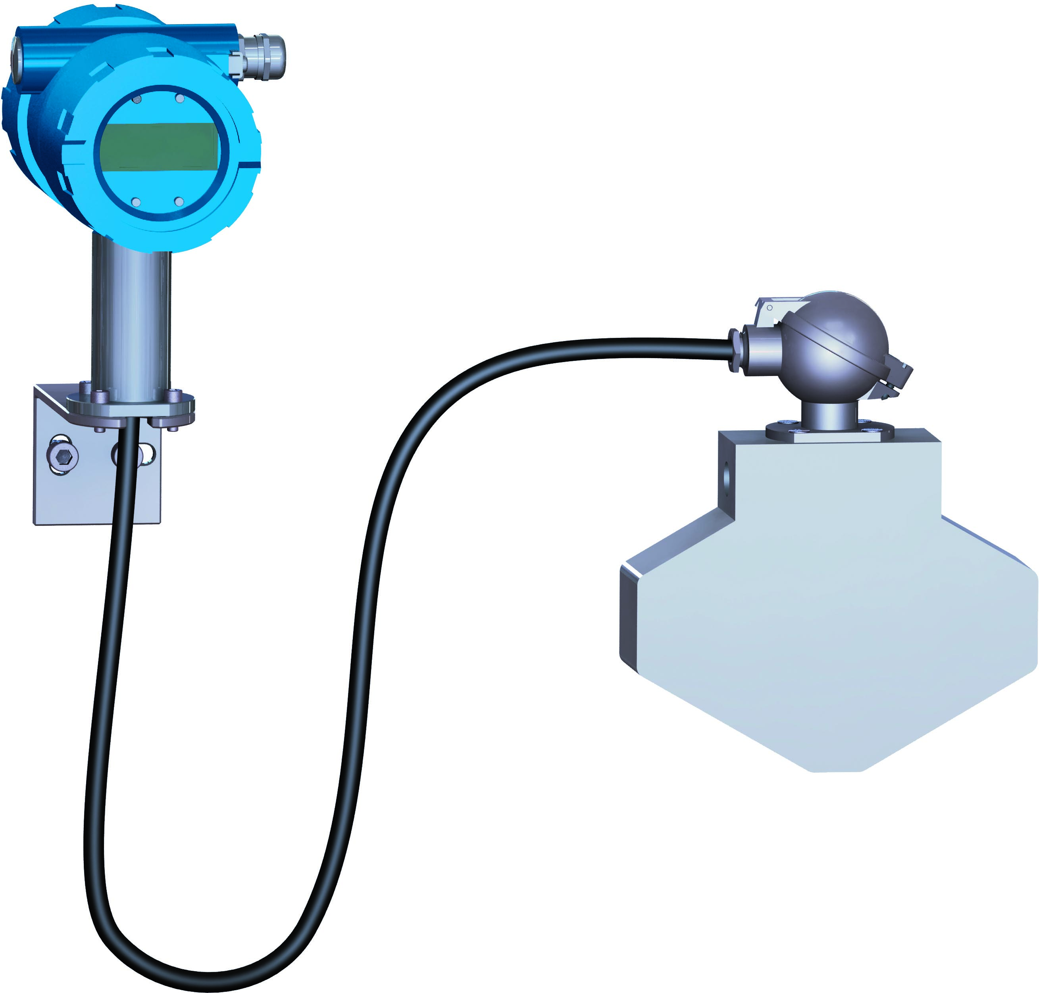
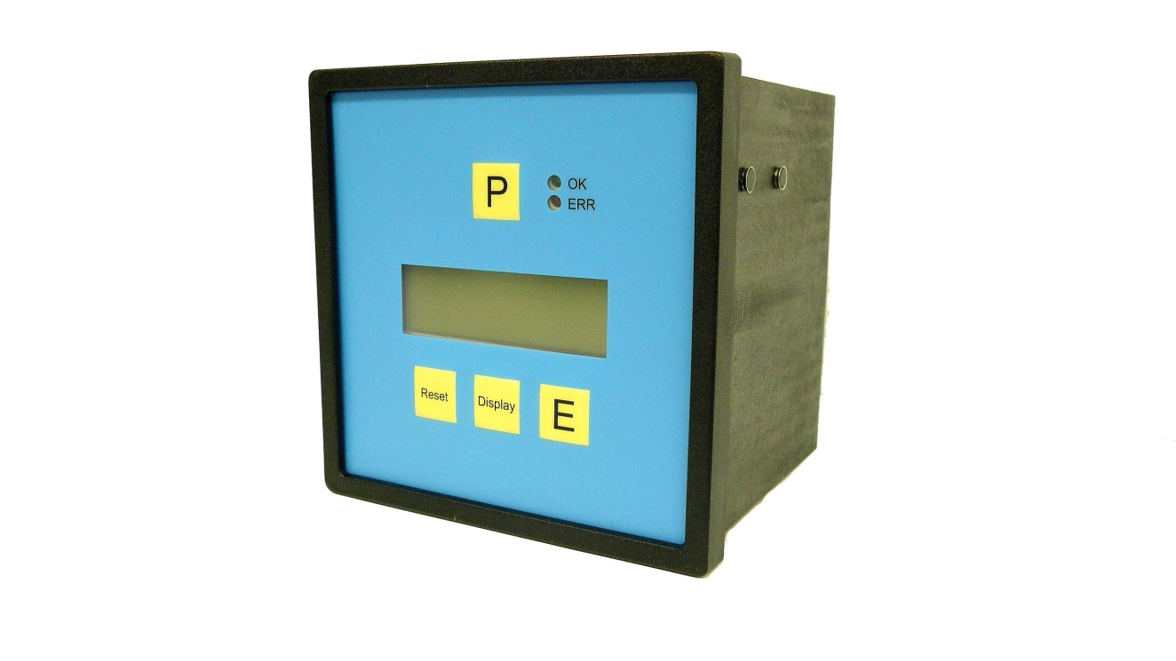
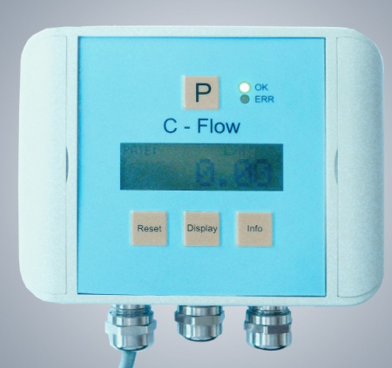
basics & principles
basics & principles
System Setup
  Compact version
  Best EMC behavior
  (EMC = Electro Magnetic Compatibility)
  “Unfriendly” ambient conditions
  Uncomfortable position for Display
  Remote version
  Better ambient conditions for the electronics
  Up to 20m cable between meter and electronics
  Freely selectable display position
  Compact version with remote display
  Very good EMC behavior
  Freely selectable display position
  Up to 1000m between meter and display
  Unfriendly ambient conditions for the electronics

Slide 10
basics & principles
basics & principles
|
Manual control
  Graphic Display with backlight and 4 Softkeys
  Easy, intuitive menu structure
  Free display orientation in 90° steps
  Display can be removed and remounted during operation
Control Inputs and Outputs
  2 independent passive 4 – 20mA outputs (for all parameters)
  Frequency output (for flow)
  Control output (meter status, limits or batching)
  Control input
  RS485 Interface
  HART Interface (Option)
  Foundation Fieldbus (Option)

Slide 11
general applications
general applications
Painting application
  The facts:
  Coriolis is a slow meter type, typical response time >> 1 second
  Slow response time ➔ stable reading but bad reaction to fast changing flow
  Fast response time➔ good reaction to fast changing flow but unstable reading
  Painting requires fast response (flow pulses down to 0.2s)
  ➔ KEM “Fast Paint Electronics”
  Coriolis flow meters have a settable step response
  With a proper set step response the tricor meter combine a stable reading at constant flow with a fast response to changing flow

Slide 12
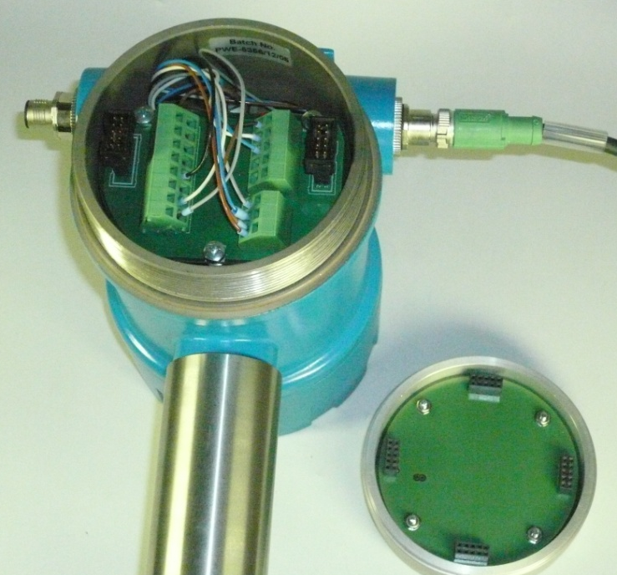
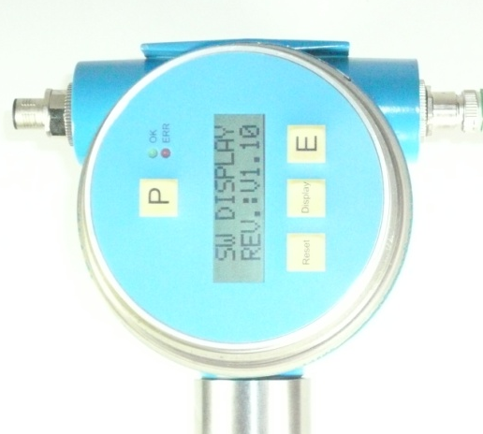
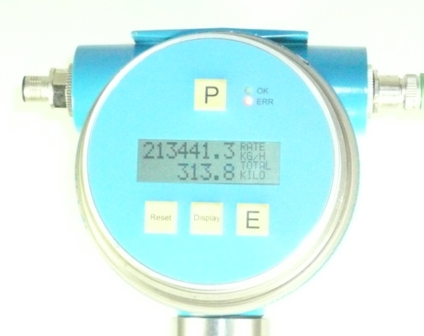
highlights
highlights
Rotatable Display

Slide 13
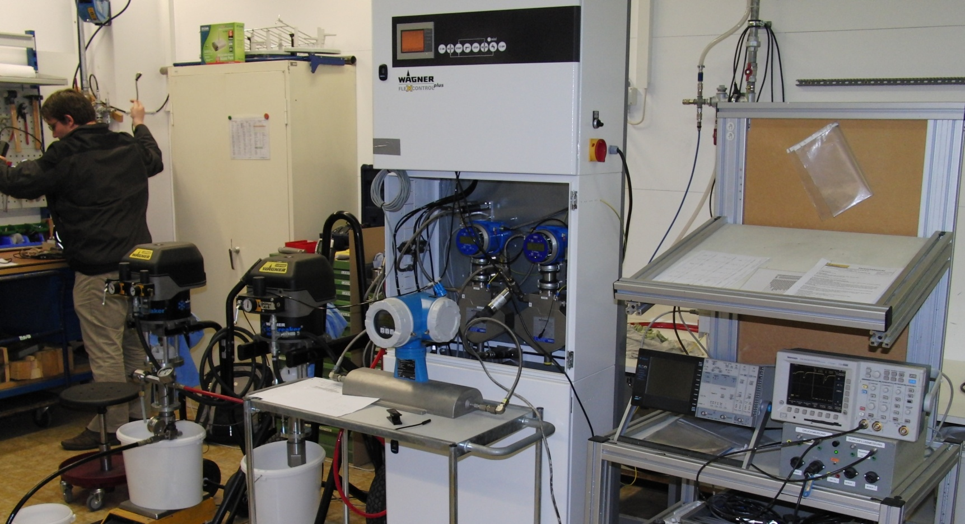
applications
applications
Application: 2 component painting

Slide 14
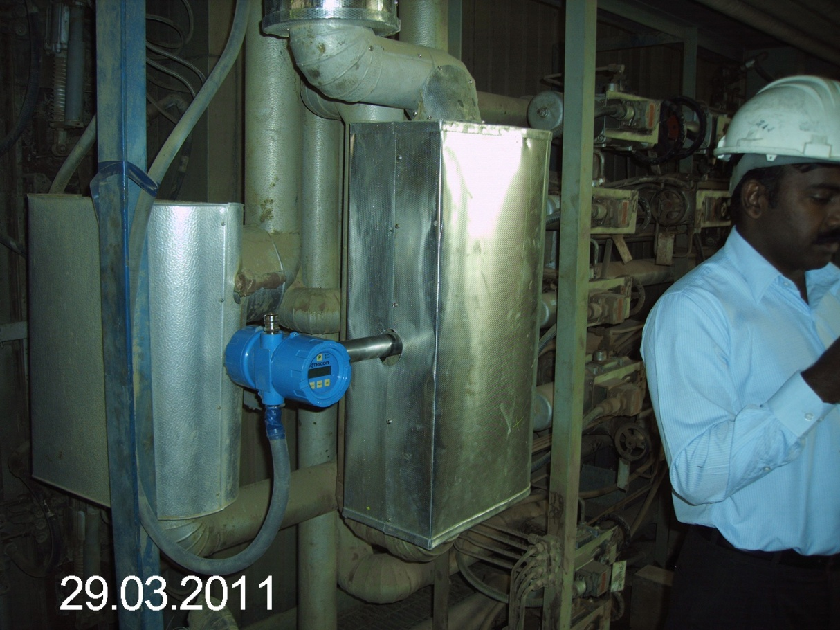
basics & principles
basics & principles
Application: power plant fuel measur.

Slide 15
competitive advantages
competitive advantages
Support and Service
  Evaluation of requirements and planning support
  Recommendations based on multiple technologies
  After sales support
  On site support (if required)
  Remote control SW for support (for trained KEM service personnel only)
  Remote control SW for the customers (will be available this year)

